Slide 1
Dynamic Programming

Slide 2
Problem of the DAY
There are given N ropes of different lengths, we need to connect these ropes into one rope. The cost to connect two ropes is equal to sum of their lengths. The task is to connect the ropes with minimum cost.
Example:
n = 4 ;arr[] = {4, 3, 2, 6} Output: 29

Slide 3
Dynamic Programming
Generally used for solving optimization problems
Finding the largest, smallest, highest, etc.
The main characteristic of dynamic programming is that we solve several overlapping subproblems
The results of these subproblems are combined to find solutions of larger subproblems, and so on, until we can solve the entire problem

Slide 4
Dynamic Programming vs Divide and Conquer
Both divide and conquer and dynamic programming use recursion
Divide and conquer also solves non-overlapping subproblems
Dynamic programming is used to solve overlapping subproblems
Divide and Conquer
Dynamic Programming

Slide 5
Fibonacci Series
The Fibonacci series is such that the each number is the sum of the last two numbers occurring before it in the series
1,1,2,3,5,8,13,21,34,….
Problem: Given an integer n find the n^{th} Fibonacci number
N=0 => 1
N=1 => 1
N=2 => 2
N=3=> 3
N=4 => 5
N=5=> 8

Slide 6
Naïve Method
Fibonacci(n)
If n=0 or n=1
Result=1
Else
Result=Fibonacci(n-1)+Fibonacci(n-2)
Return Result
What is the complexity of this algorithm ?

Slide 7
Naïve Method
Time to solve Fibonacci (n) is O(2^{n})
Complexity is T(n)=T(n-1)+T(n-2); T(0)=1
T(n)=T(n-1)+T(n-2)
< 2T(n-1)
<2²T(n-2)…< 2^{k}T(n-k)
Recursion ends when k=n
T(n) )< 2^{n}T(n-n)=O(2^{n})
Can we do better ?
To do so, first understand why the complexity is high

Slide 8
Fibonacci(n)
F(n)
F(n-1)
F(n-2)
F(n-3)
F(n-2)
F(n-3)
F(n-4)
F(n-3)
F(n-4)
F(n-4)
F(n-5)
F(n-4)
F(n-5)
F(n-5)
F(n-6)
Note that the same Fibonacci value is used multiple times, and has to be recomputed
This increases the time complexity
Solution: store the results as they are computed

Slide 9
Dynamic Programming Method
Fibonacci(n)
F[0]=0;
F[1]=1;
For(i=2; i<=n;i++)
F[i]=F[i-1]+F[i-2]
Return F[n]
What is the complexity of this algorithm ?
One for loop of n-1 iterations
But also requires O(n) memory
How can you optimize the space ?

Slide 10
To Recap
Divide and Conquer: non-overlapping subproblems
Dynamic Programming: overlapping subproblems
The same problem can be written using divide and conquer as well as dynamic programming (the complexity differs)

Slide 11
Maximum Subset Sum
Given an array of numbers find the maximum sum of contiguous numbers
-2
-3
4
-1
-2
1
5
-3
Maximum subarray sum: 7

Slide 12
Maximum Subset Sum: Dynamic Programming
-2
-3
4
-1
-2
1
5
-3
Local_max= 0
Global_max=0
Local_max= 3
Global_max=4
Local_max= 7
Global_max=7
Local_max= 0
Global_max=0
Local_max= 1
Global_max=4
Local_max= 4
Global_max=7
Complexity:
T(n)=O(n)
But need to store intermediate sums
Local_max= 4
Global_max=4
Local_max= 2
Global_max=4
Local max= Maximum Subset sum for the current sequence
Global max= Maximum subset sum across all sequences

Slide 13
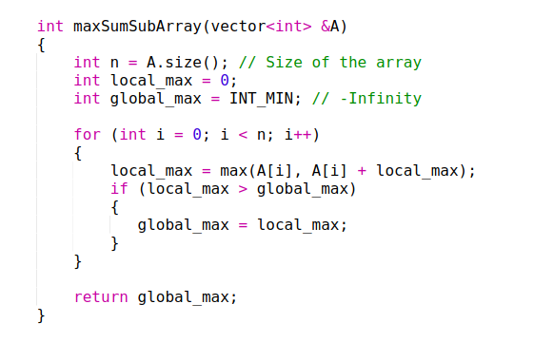
Maximum Subset Sum: Dynamic Programming
Kadane’s Algorithm

Slide 14
Examples
Given a set of non negative numbers, for example:
{1,4,9,3, 7,6,5,2}
Determine whether divide and conquer or dynamic programming would be most efficient for the following problems
Finding the maximum
Finding if a given number, i.e. 3, is in the set of numbers
Finding whether a subset of the numbers can add to a given number. For example, can a subset of the numbers add to 10 (yes 4+6; 9+1; 5+2+3)

Slide 15
Characteristics of Dynamic Programming
Have to consider all possible subsets/options
Recall all possible subsets of n items is 2^{n}
However if we store the smaller subsets and the results, we can update for larger subsets
So we need
A method to update the results as we increase size of subsets
Memory to store previous results that need to be updated

Slide 16
Subset Sum Problem
Given a set of positive, non repeating numbers
Given the sum which is a positive number
Is there a subset of numbers from the set that when added will produce the sum ?
Example:
Set: {4,6,5,3,7} Sum:13
Answers: Yes {4,6,3}

Slide 17
Naïve Method
Check all subsets, and see if they add to the given sum
{4}, {6}, {5}, {3}, {7}
{4,6}, {4,5}, {4,3}, {4,7}, {6,5}, {6,3}, {6,7}, {5,3}, {5,7}, {3,7}
{4,6,5}, {4,6,3},{4,6,7}, {6,5,3}, {6,5,7}, {5,3,7}
{4,6,5,3},{4,6,5,7},{6,5,3,7}
{4,6,5,3,7}
What is the complexity ?
Time to add = 1*^{n}C₁+ 2*^{n}C₂ + 3*^{n}C₃+… + n*^{n}C_{n}=n*2^{(n-1)}

Slide 18
Identifying Overlapping Subproblems
Lets check the overlapping subproblems in the list
{4}, {6}, {5}, {3}, {7}
{4,6}, {4,5}, {4,3}, {4,7}, {6,5}, {6,3}, {6,7}, {5,3}, {5,7}, {3,7}
{4,6,5}, {4,6,3},{4,6,7}, {6,5,3}, {6,5,7}, {5,3,7}
{4,6,5,3} ,{4,6,5,7}, {6,5,3,7}
{4,6,5,3,7}

Slide 19
Recursion
Set={2,1,3}
Sum=4
SubsetSum(Array,Start_Index,Sum)
If sum=0;
then return true; (since 𝜙 is a subset)
Else
(i) We include the current element in the sum
Sum=Sum-Array[Start_Index ];
S1=SubsetSum(Array,Start_Index-1,Sum)
(ii) We do not include the current element in the sum
S2=SubsetSum(Array,Start_Index-1,Sum)
Return S1||S2
(A,0,4) { }
(A,1,2) {2}
(A,2,1) {2,1}
(A,2,2)
{2}
(A,1,4) { }
(A,2,3) {1}
(A,2,4) { }
(A,3,-2)
{2,1,3}
(A,3,1)
{2,1}
(A,3,-1)
{2,3}
(A,3,2)
{2}
(A,3,0)
{1,3}
(A,3,3)
{1}
(A,3,1)
{3}
(A,3,4)
{}
Complexity
T(n)=2T(n-1)

Slide 20
Subset Sum: Dynamic Programming
We will need a two dimensional array (called subset), to keep track of the intermediate sum and the index
// Returns true if there is a subset of set[] with sum equal to given sum
bool isSubsetSum(int set[], int n, int sum)
{ // Base Cases
if (sum == 0) return true;
if (n == 0) return false;
// If last element is greater than sum, then ignore it
if (set[n - 1] > sum)
return isSubsetSum(set, n - 1, sum);
/* else, check if sum can be obtained by any of the following:
(a) including the last element
(b) excluding the last element */
return isSubsetSum(set, n - 1, sum)
|| isSubsetSum(set, n - 1, sum - set[n - 1]);
}
Code from:https://www.geeksforgeeks.org/subset-sum-problem-dp-25/
Complexity=O(Sum*n)
Set={2,1,3}
Sum=4
 | 0 | 1 | 2 | 3 | 4
{2} | T | F | T {2} | F | F
{2,1} | T | T{1} | T{2} | T{2,1} | F
{2,1,3} | T | T{1} | T{2} | T{2,1},{3} | T{3,1}

Slide 21
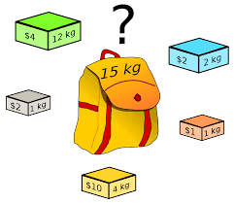
0-1 Knapsack Problem
Given a set of n items ;
Items cannot be subdivided
Value of ith item is vi and its weight is wi
Your Knapsack can hold at most W weight
Which items should you pick to maximize the value

Slide 22
0-1 Knapsack Problem
Notice the similarity with the subset sum problem
Naïve method can be checking every subset---which is expensive
Recursive method is for each item,
either select the ith item, and subtract the weight
Or do not select the ith item and maintain the weight

Slide 23
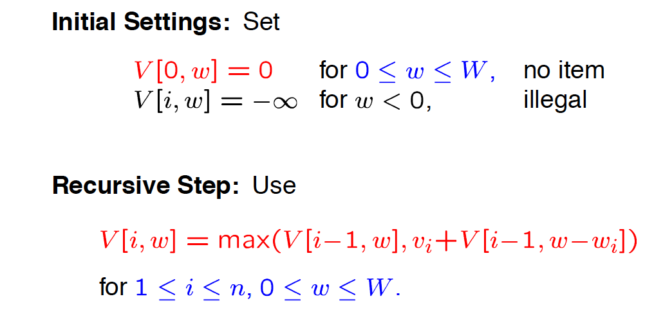
Don’t include item i and maintain weight
Include item i and subtract its weight
Let V[i,w] store the maximum value of any set of items from 1 to I, with weight W

Slide 24
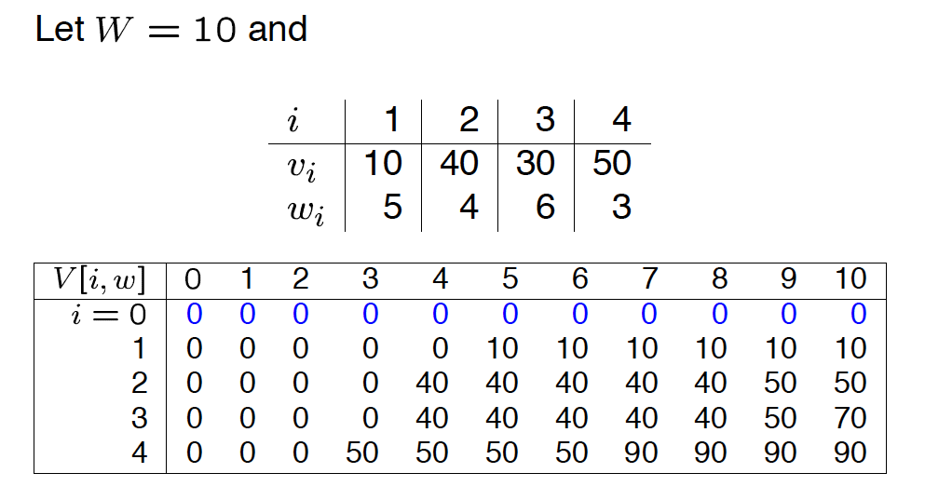
Complexity O(nW)

Slide 25
Pseudo-Polynomial Complexity
Subset sum and 0-1knapsack are examples of problems with pseudopolynomial complexity
A numeric algorithm runs in pseudo-polynomial time if its running time is a polynomial in the numeric value of the input (the largest integer present in the input) — but not in the length of the input (the number of bits representing it).
The subset sum and 0-1 knapsack have complexity O(nW);
This means order of W steps
But representing W only takes log(W)
So number of steps exponential to length of the input

Slide 26
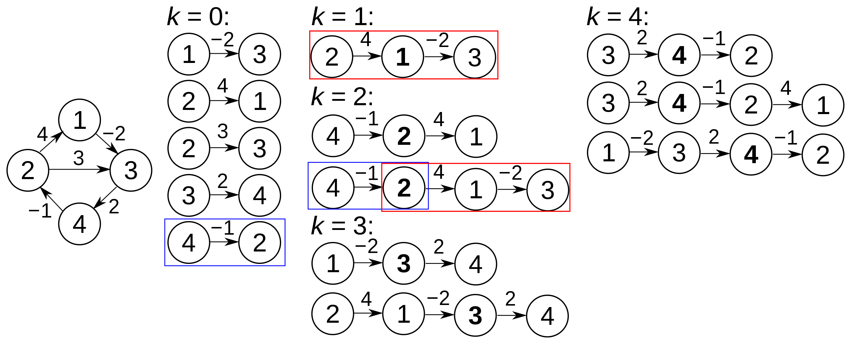
ALL PAIR SHORTEST PATH
APSP finds the shortest path between all pairs of vertices
Uses dynamic programming
Can handle negative weights, but not negative cycles
Floyd Warshall Algorithm (1959, Roy; 1962 Floyd, Warshall)
Initialize all entries in |V|x|V| matrix d to INF
For each edge(u,v)
d[u][v]=w(u,v)
For each vertex v
d[v][v]=0
For k=1 to|V|
For j=1 to|V|
For i=1to |V|
If d[i][j]>d[i][k]+d[k][j]
d[i][j]=d[i][k]+d[k][j]
Complexity O(|V|³)
By Dcoetzee - Own work, CC0, https://commons.wikimedia.org/w/index.php?curid=23230210

Slide 27
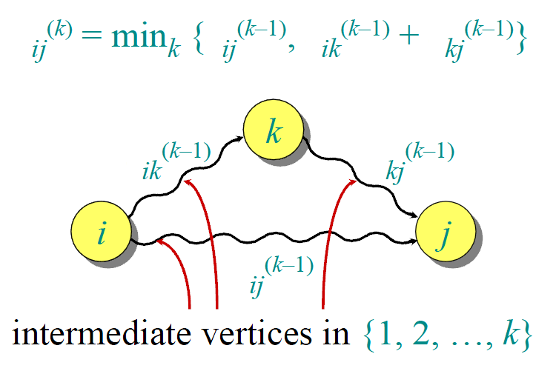
Recursive structure in the algorithm
d_{ij}(k) = weight of a shortest path from i to j with intermediate
vertices belonging to the set {1, 2, …, k}.
d
d
d
d
How to find All Pairs Shortest Paths?
Compute the d_{ij}(k) values in order of increasing values of k.
d
d
d

Slide 28
Example
V₁
V₂
V₃
V₄
V₅
V₁
0
3
8
∞
-4
V₂
V₂
∞
0
∞
1
7
3
4
V₃
∞
4
0
∞
∞
7
V₁
V₃
V₄
2
∞
-5
0
∞
8
V₅
∞
∞
∞
6
0
2
1
-4
-5
V₁
V₂
V₃
V₄
V₅
V₅
6
V₄
V₁
-
1
1
-
1
V₂
-
-
-
2
2
V₃
-
3
-
-
-
V₄
4
-
4
-
-
V₅
-
-
-
5
-

Slide 29
K=1
V₁
V₂
V₃
V₄
V₅
V₂
V₁
0
3
8
∞
-4
3
4
V₂
∞
0
∞
1
7
7
V₃
∞
4
0
∞
∞
V₁
V₃
8
V₄
2
5
-5
0
-2
2
1
V₅
∞
∞
∞
6
0
-4
-5
V₁
V₂
V₃
V₄
V₅
V₅
6
V₄
V₁
-
1
1
-
1
V₂
-
-
-
2
2
D_{i,j}⁽¹⁾=min(D_{i,j}⁽⁰⁾, D_{i,1}⁽⁰⁾+D_{1,j}⁽⁰⁾)
Allowed intermediate vertices: subset of {V1}
V₃
-
3
-
-
-
V₄
4
1
4
-
1
V₅
-
-
-
5
-

Slide 30
K=2
V₁
V₂
V₃
V₄
V₅
V₁
0
3
8
4
-4
V₂
V₂
∞
0
∞
1
7
3
4
V₃
∞
4
0
5
11
7
V₁
V₃
V₄
2
5
-5
0
-2
8
V₅
∞
∞
∞
6
0
2
1
-4
-5
V₁
V₂
V₃
V₄
V₅
V₅
6
V₄
V₁
-
1
1
2
1
V₂
-
-
-
2
2
D_{i,j}⁽²⁾=min(D_{i,j}⁽¹⁾, D_{i,2}⁽¹⁾+D_{2,j}⁽¹⁾)
V₃
-
3
-
2
2
Allowed intermediate vertices:
subset of {V1,V2}
V₄
4
1
4
-
1
V₅
-
-
-
5
-

Slide 31
K=3
V₁
V₂
V₃
V₄
V₅
V₁
0
3
8
4
-4
V₂
V₂
∞
0
∞
1
7
3
4
V₃
∞
4
0
5
11
7
V₁
V₃
V₄
2
-1
-5
0
-2
8
V₅
∞
∞
∞
6
0
2
1
-4
-5
V₁
V₂
V₃
V₄
V₅
V₅
6
V₄
V₁
-
1
1
2
1
V₂
-
-
-
2
2
D_{i,j}⁽³⁾=min(D_{i,j}⁽²⁾, D_{i,3}⁽²⁾+D_{3,j}⁽²⁾)
Allowed intermediate vertices: subset of {V1,V2,V3}
V₃
-
3
-
2
2
V₄
4
3
4
-
1
V₅
-
-
-
5
-

Slide 32
K=4
V₁
V₂
V₃
V₄
V₅
V₁
0
3
-1
4
-4
V₂
V₂
3
0
-4
1
-1
3
4
V₃
7
4
0
5
3
7
V₁
V₃
V₄
2
-1
-5
0
-2
8
V₅
8
5
1
6
0
2
1
-4
-5
V₁
V₂
V₃
V₄
V₅
V₅
6
V₄
V₁
-
1
4
2
1
V₂
4
-
4
2
4
D_{i,j}⁽⁴⁾=min(D_{i,j}⁽³⁾, D_{i,4}⁽³⁾+D_{4,j}⁽³⁾)
Allowed intermediate vertices: subset of {V1,V2,V3,V4}
V₃
4
3
-
2
4
V₄
4
3
4
-
1
V₅
4
3
4
5
-

Slide 33
K=5
V₁
V₂
V₃
V₄
V₅
V₁
0
1
-3
2
-4
Done!
V₂
V₂
3
0
-4
1
-1
3
4
V₃
7
4
0
5
3
7
V₁
V₃
V₄
2
-1
-5
0
-2
8
V₅
8
5
1
6
0
2
1
-4
-5
V₁
V₂
V₃
V₄
V₅
V₅
6
V₄
V₁
-
5
5
5
1
D_{i,j}⁽⁵⁾=min(D_{i,j}⁽⁴⁾, D_{i,5}⁽⁴⁾+D_{5,j}⁽⁴⁾)
Allowed intermediate vertices: subset of {V1,V2,V3,V4,V5}
V₂
4
-
4
2
4
V₃
4
3
-
2
4
V₄
4
3
4
-
1
Trace back the shortest path between v3,v5: V3→v2→v4→v1→v5
V₅
4
3
4
5
-

Slide 34
Subsequence of a String
Given a sequence X=<x1,x2, …xm>, the sequence Z= <z1,z2,…zk> is a subsequence of X if there is a strictly increasing sequence <i1, i2,…ik> such that for all j=1,2,…k x_{ij}=z_{j}
X=<A,B,C,B, D,A,B> then a subsequence is
Z=<B,C, D,B> and the sequence index is <2,3,5,7>
Y=<B,D,C> is not because B,D,C do not appear in that order in X

Slide 35
Longest Common Subsequence
Given two sequences X and Y, Z is a common subsequence of X and Y if Z is a subsequence of both X and Y
X=< A,B,C,B, D, A, B>
Y=<B,D,C,A,B,A>
Common Subsequence <B,C,B>
Longest common subsequence (LCS) <B,C, B,A>
Goal : To find one of the longest common subsequences of a pair of sequences
This is used in comparing between two genetic/protein sequences.

Slide 36
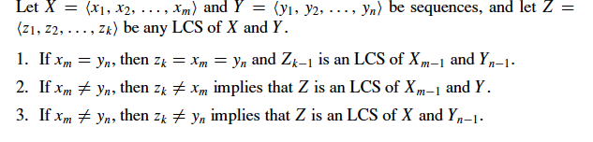

Recursion
Start from the last letters
If the last two letters match then LCS length is increased by 1
LCS of X (-last entry), and Y(-last entry)
Else. Max of
LCS of X, and Y(-last entry)
LCS of X(-last entry) and Y

Slide 37
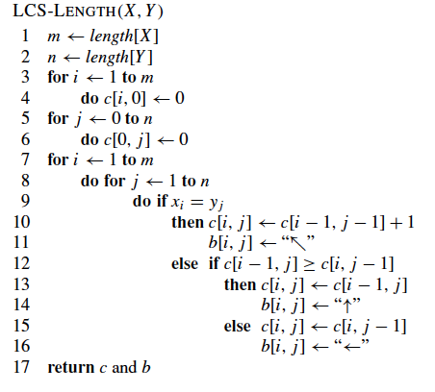
Algorithm for Computing LCS
C[i,j]= length of LCS of X(0,i) and Y(0,j)
If last two entries match, increase LCS by 1
LCS of X(-last entry),Y
LCS of X,Y(-last entry)
For loop on m and For loop on n=> O(nm)

Slide 38
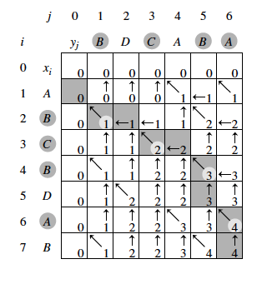
Strings being compared: X[0,i] and Y[0,j]
At entry 2,3
We are comparing
X={A,B}
Y={B,D,C}

Slide 39
Back to Fibonacci
Fibonacci(n)
Set F[1:n]=0;
If n=0 or n=1
Result=1
If F[n]>0
Result=F[n]
Else
Result=Fibonacci(n-1)+Fibonacci(n-2)
F[n]=Result
Return Result
Fibonacci(n)
F[0]=0;
F[1]=1;
For(i=2; i<=n;i++)
F[i]=F[i-1]+F[i-2]
Return F[n]
Tabulation:
Top Down
Memoization:
Bottom up

Slide 40
Storing Results
Memoization
Tabulation
Only computes the values that are needed
Goes through the recursion tree and stores results as they occur
Computes all values
Iteratively fills all the values

Slide 41
Examples
Given below are returns on investments for the amounts given in the top row. For example, investing $500 in INV2 gives back return of $30. What is optimal investment for $600 for get back the maximum return
 | 100 | 200 | 300 | 400 | 500 | 600
INV 1 | 5 | 11 | 16 | 23 | 29 | 35
INV 2 | 4 | 12 | 18 | 23 | 30 | 34
INV 3 | 4 | 5 | 5 | 30 | 30 | 35
INV 4 | 6 | 12 | 17 | 24 | 30 | 31

Slide 42
Examples
Alex can work upto 6hrs He has a choice of jobs to choose from in the Table given below. The start and end time of the jobs are flexible, but the duration is fixed. If he starts a job he has to finish it and cannot leave it in-between. He can work on multiple jobs one after another, but can work on only one job at a time (no multitasking). He cannot repeat a job. Give an algorithm to select which jobs should he do to get the most payment within the 6 hrs limit, and obtain the best value of money for time.
 | Duration in hours | Salary per hrs
J1 | 5 | 5.4
J2 | 4 | 5
J3 | 3 | 6
J4 | 2 | 4

Slide 43
Summary
Dynamic programming solves optimization problems
The optimization of subproblems can be combined to optimize the larger problem
Unlike divide and conquer, we have to check all the possible partitions to find the optimal solution

